Slide 1
INDIAN CROP PRODUCTION ANALYSIS
BY: Arpit SHArma

Slide 2
INTRODUCTION
Emcompassing dataset on State-wise Crop Production in India gave information about different seasonal crops at district level and area of cultivation along with total crop production. India being agriculture rich country, this data will have lots of minor and major facts which will help in charting a next successful agriculture revolution after 1965. “Under premiership of Congress leader Lal Bahadur Shastri, the Green Revolution within India commenced in 1965 that led to an increase in food grain production, especially in Punjab, Haryana, and Uttar Pradesh”.
Doing an exploratory data analysis of this dataset would give insights into Indian agriculture status: state-wise, district-wise, crop-wise, area-wise and levels of productions. A complete analysis will paint a beautiful story of this important aspect of India.

Slide 3
Data Preparation and Cleaning
Data preparation or Data preprocessing is very crucial step in a Data Science project pipeline. This process includes, accessing different variables and verifying the accuracy of data collected. Working on missing data(either deleting it or imputing with appropriate measures). Outliers are also datapoints which has to flagged and investigated if they are conducive for including in the analysis.

Slide 4
What’s Inside The Dataset
Dimensions of the dataset is 246091 rows and 7 columns.
Out of seven variables, we have four categorical variables(State name ,District name, Season and Crop type) and three continuous variables in float(Area and Production) and integer(Crop Year) format.
Checking for missing values showed Production variable showing huge number of missing values amounting to 3730 values and no missing values for other variables. Next step would be dropping these samples as we have sufficiently big dataset. Missing value accounts for only 1.5% of total sample size.

Slide 5
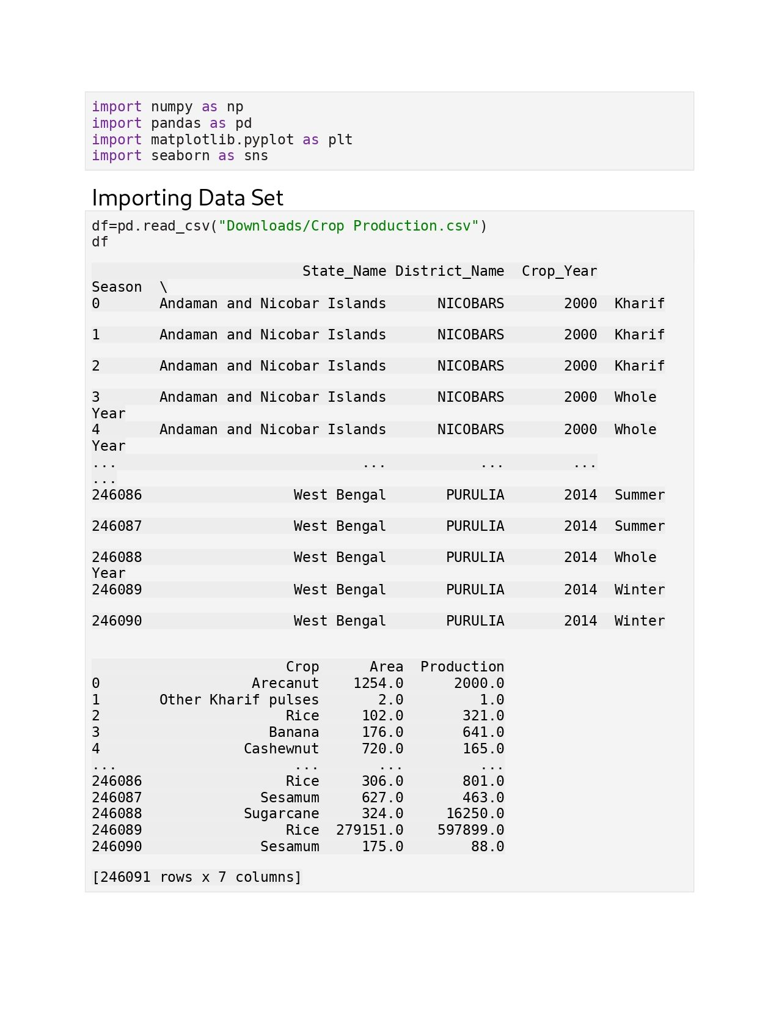

Slide 6
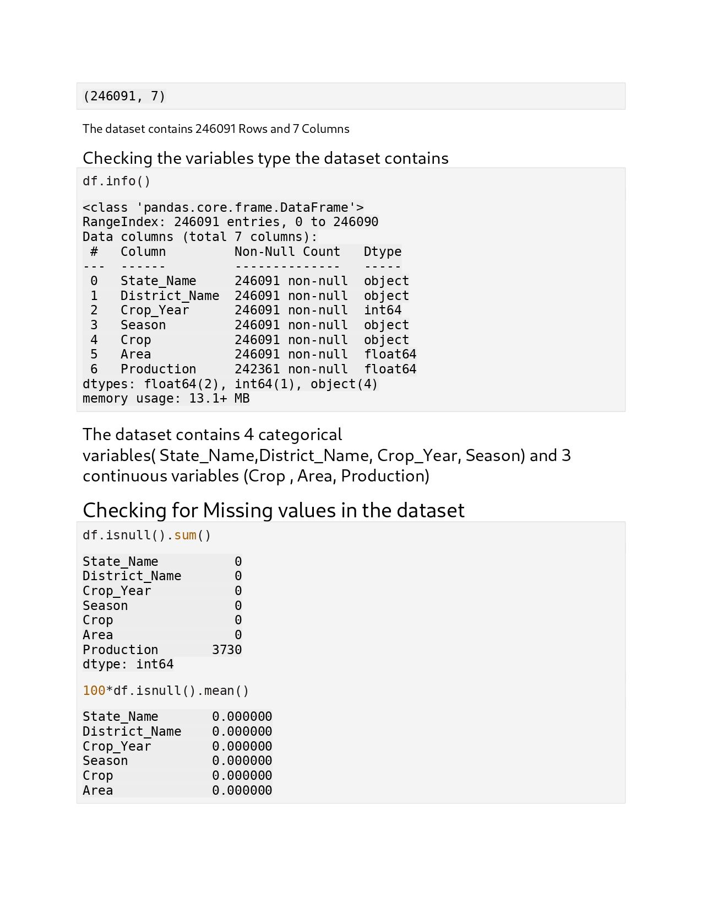

Slide 7
Univariate Analysis
This dataset encodes agriculture data for 33 Indian states (including Union Territory). Df.value_counts() helps to see the quantum of levels present. We have more data from top agriculture rich states like Uttar Pradesh, Madhya Pradesh and Karnataka than other states.
On District front, we have more data coming from Tumkur, Belgaum, Hassan, Bellary and Bijapur from Karnataka state.
Dataset talks of six different seasons i.e. Kharif, Annual, Autumn, Rabi, Summer and Winter crops with more crops yielding in Winter. Frequency wise, we have more data points from Kharif, Rabi and Annual crop types.

Slide 8
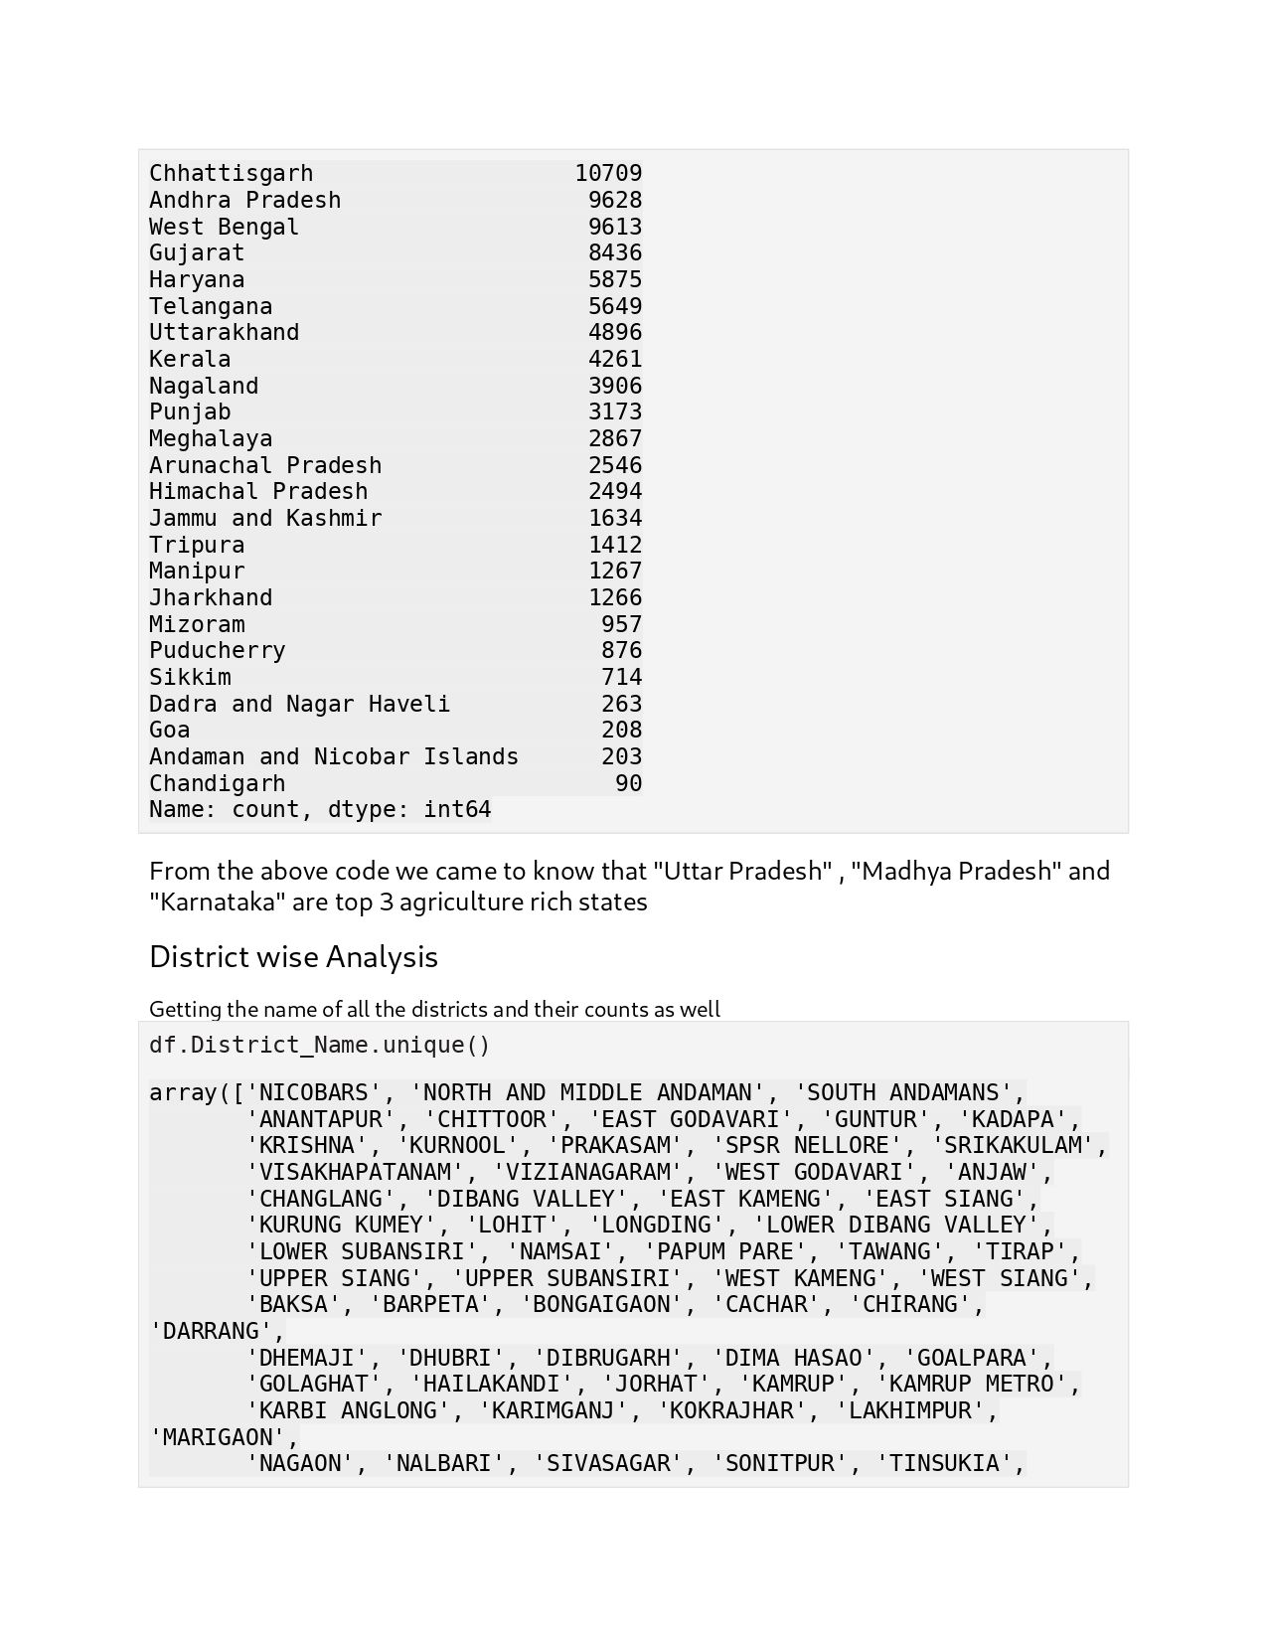

Slide 9
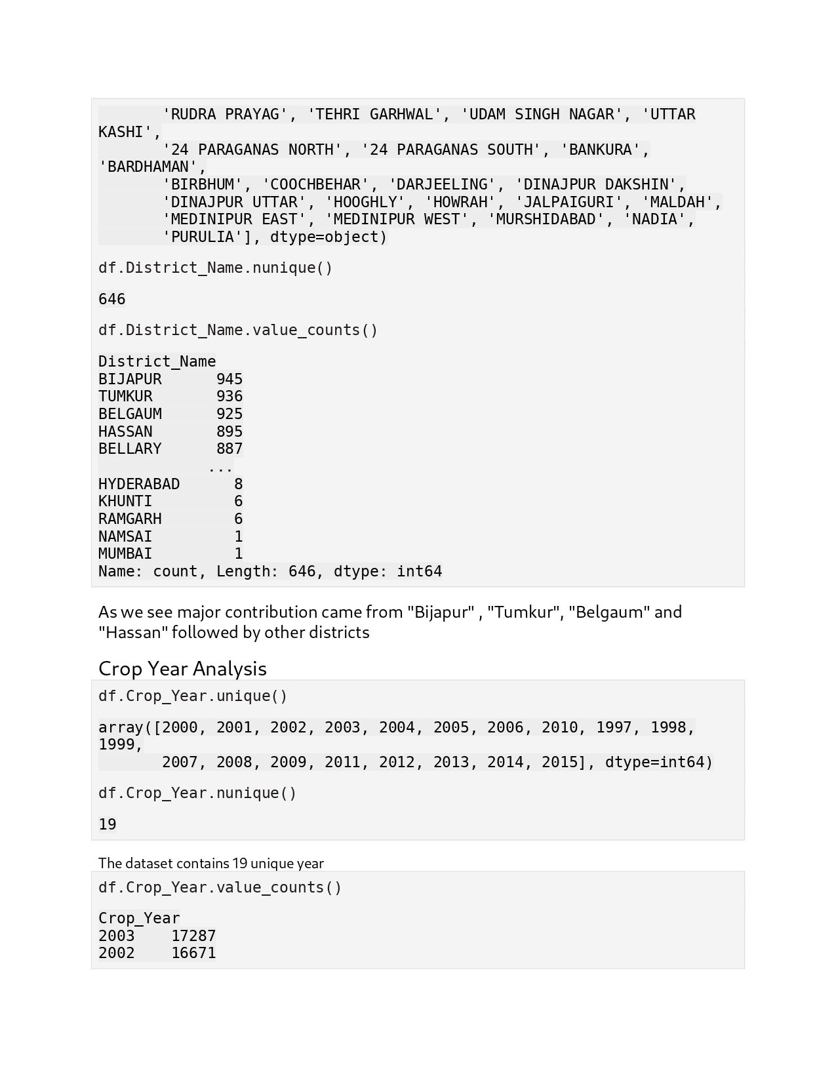

Slide 10
New Variables
Looking at the seven variables, we could extract more information if new variable could be created using present variables. Some of the possibilities are:
Different zones (Union Terr, South Zone, NE Zone, East Zone, North Zone, Central Zone and West Zone)
Different categories (Cereal, Pulses, Fruits, Beans, Vegetables, Spices, Fiber, Nuts, Natural Polymers, Coffee, Tea, Total foodgrain, Pulses, Oilseeds, Paddy, Commercial, Sugarcane, forage plants and Others)
Using Zonal information, we can decipher the top zones are South India, North India and East India.
Top frequency of crop types are Cereal, Pulses and oilseeds.
Production wise top zone is South India

Slide 11
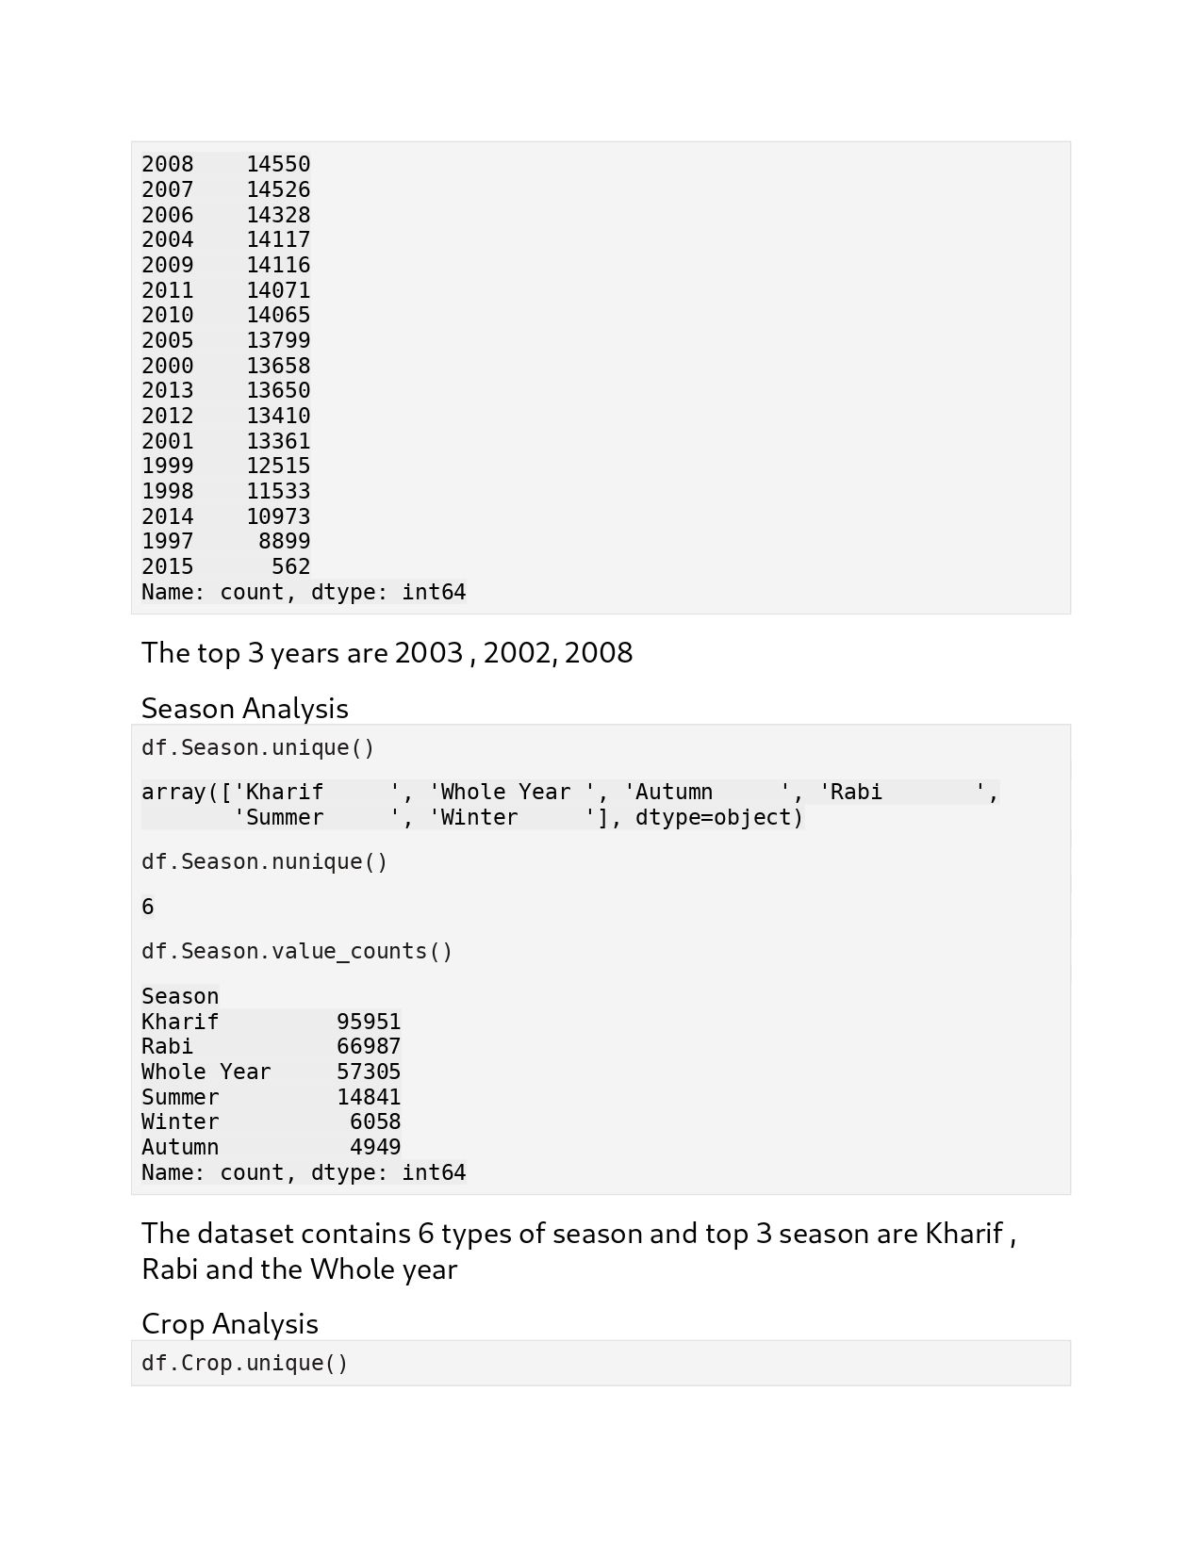

Slide 12
Cereal , Pulses, Oilseeds are the top three most produced crop categories.
Top producing state Kerala shows has majority production of whole year seasonal crops.
Top producing state Uttar Pradesh has majority production of Kharif, Rabi and Summer crops.

Slide 13
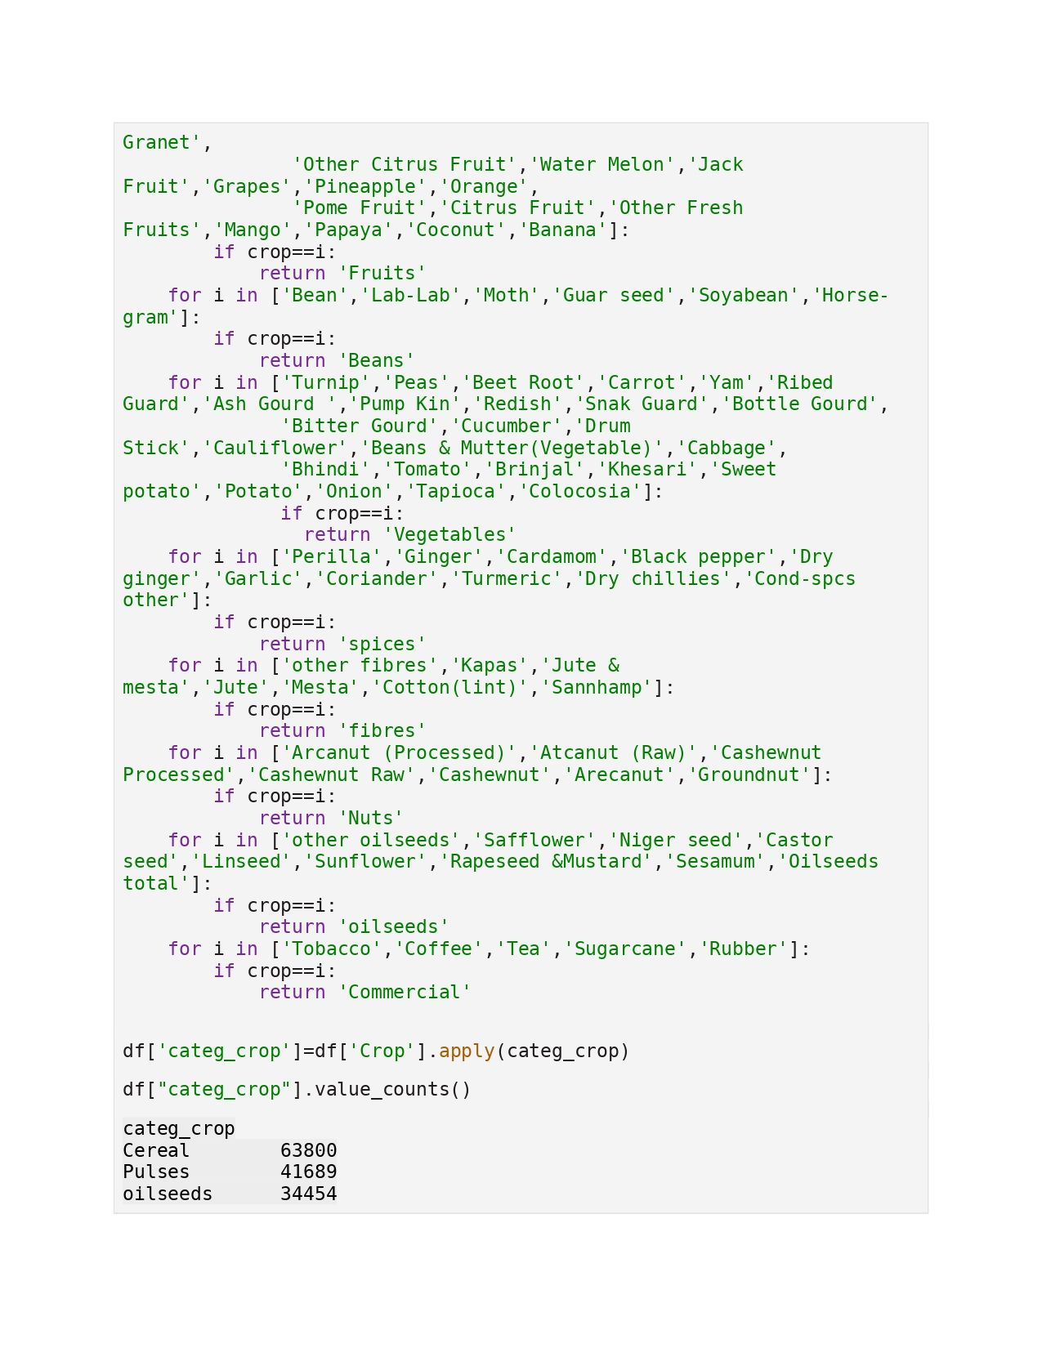

Slide 14
Special Thanks 🙏🏻
I would like to extend my heartfelt gratitude to Unified Mentor Private Limited for providing me with an incredible internship opportunity. This experience has been invaluable in furthering my professional development and gaining practical insights into the industry. The supportive and dynamic environment fostered by Unified Mentor Private Limited has enabled me to enhance my skills, gain hands-on experience, and contribute meaningfully to ongoing projects. The guidance and mentorship provided by the team have been instrumental in shaping my understanding and application of theoretical knowledge. Thank you, Unified Mentor Private Limited, for this enriching opportunity and for playing a pivotal role in my career journey.

